Slide 1
NFC/RFID Controller
By: Robert Dinh
CENG317-0NA

Slide 2

Introduction (Proposal)
Contactless Payment with NFC has become popular over the last decade
Introducing it to the Parts Crib will be more helpful and convenient for both staffs and students
Parts Crib Interaction
Students select the items from the Android/Web Browser Application
Students arrive at the crib and tap their phones
Staff looks at their profile and grabs the requested items
On return, students tap their phone and the staff confirms if all items have been returned.

Slide 3
Budget
Everything was under budget due to owned parts, tools and provided services
Owned: Raspberry Pi 2 B, Electronic Parts kit, Tools
Provided: PCB (Prototype Lab), 3d Printed Case (Humber Library and Brampton Public Library)
Description | Source | Part # | Price (CAD) | Quanitity | CAD$ Subtotal
NFC/RFID controller breakout board - v1.6 | kjdElectronics via Amazon | PN532 | $57.73 | 1 | $57.73*
Import fees for PN532 |  |  |  | 1 | $7.74
Reason for refund: Export fee reduced |  |  |  | 1 | -$0.27
4x 10 Pin Stackable Header | Syal Missassauga |  | $3.50 | 1 | $3.50
Assortment Stackable Headers |  |  | $3.95 | 1 | $3.95
Lead Free Solder | Syal Missassauga |  | $6.95 | 1 | $6.95
Nylon Screws/Nuts/Standoffs | SunFounder via Amaon |  | $13.99 | 1 | $13.99
Glue Gun | HomeDepot |  | $7.99 | 1 | $7.99
 |  |  |  | SubTotal | $101.58
* NOT TAXED |  |  |  | TAX(13%) | $4.73
 |  |  |  | Total(CAD) | $106.31

Slide 4
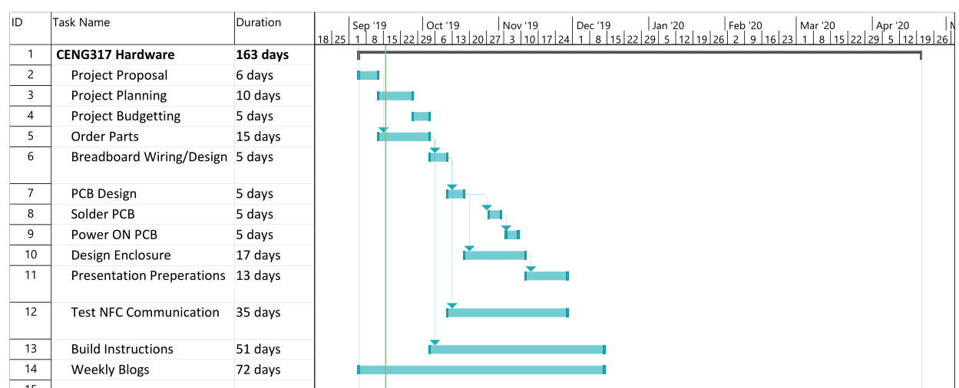
Schedule

Slide 5
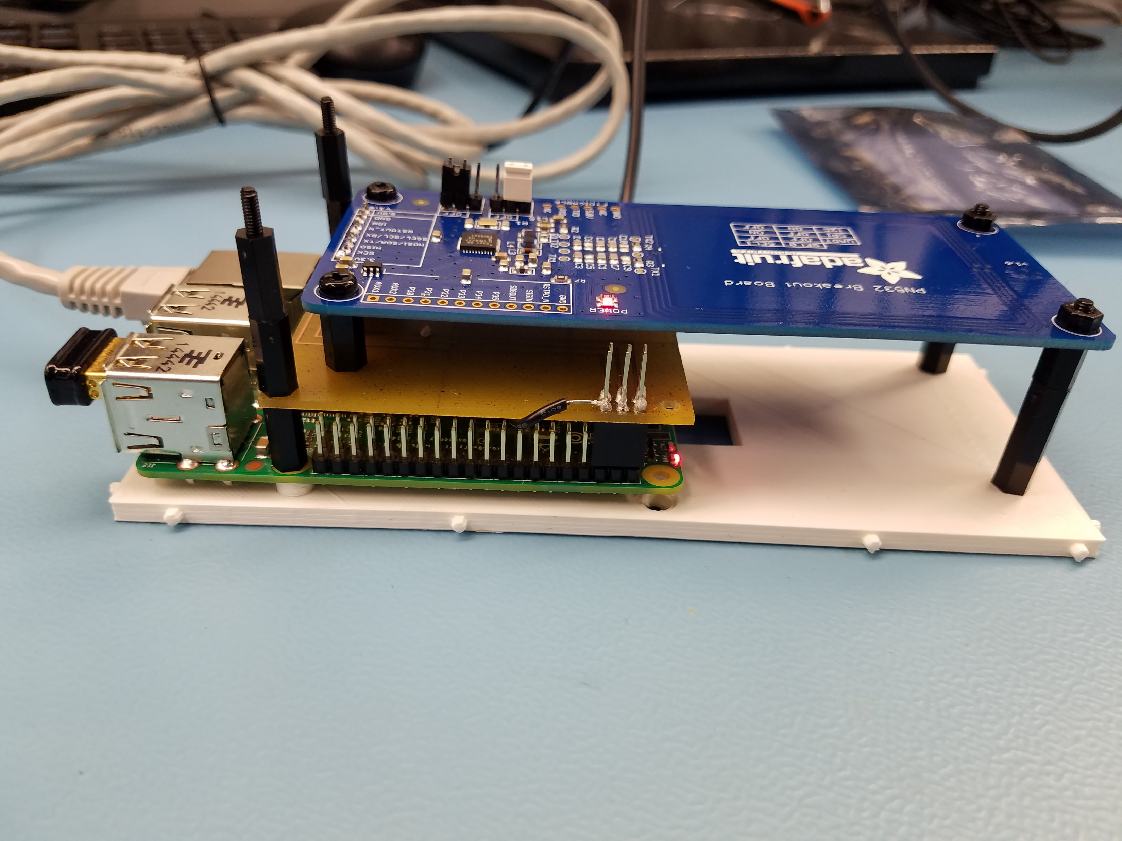
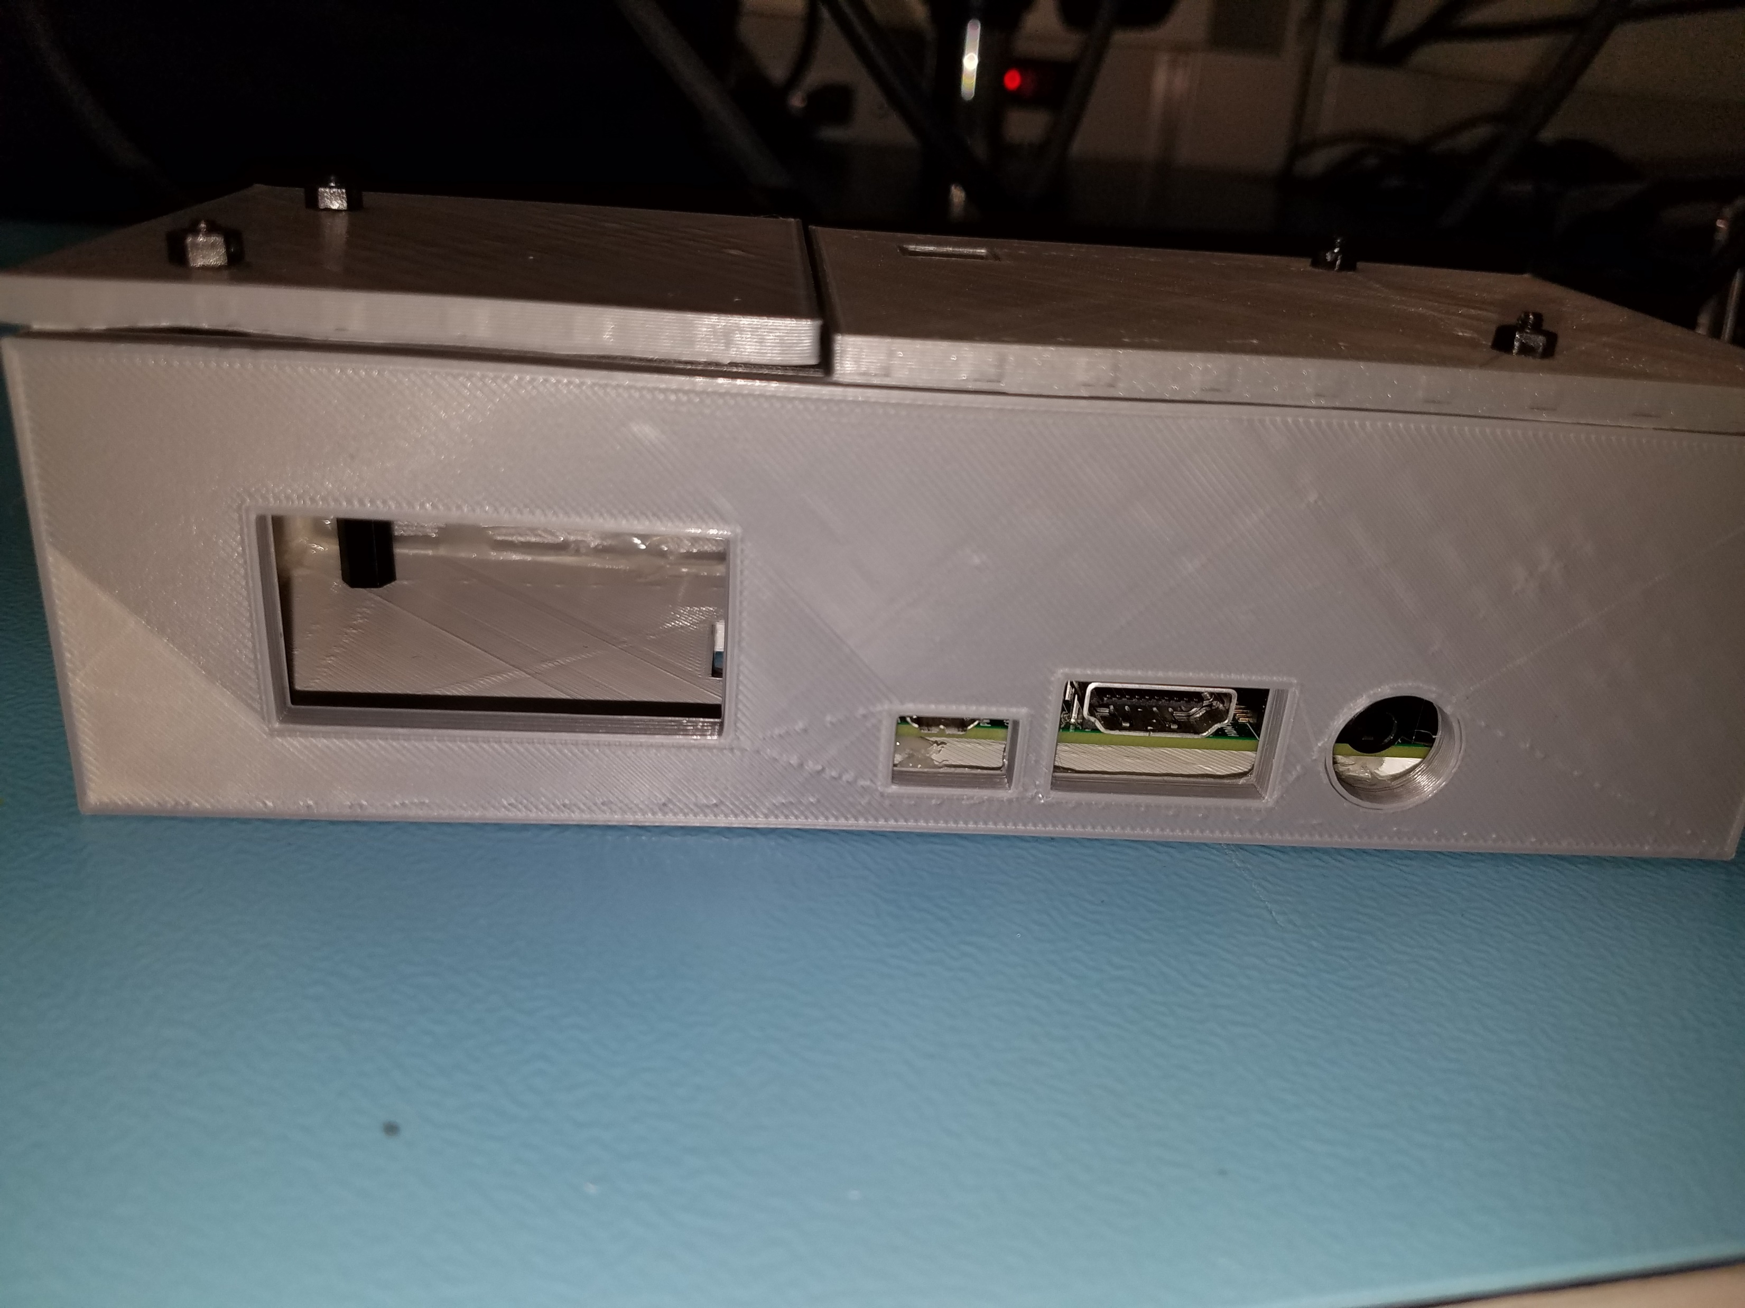
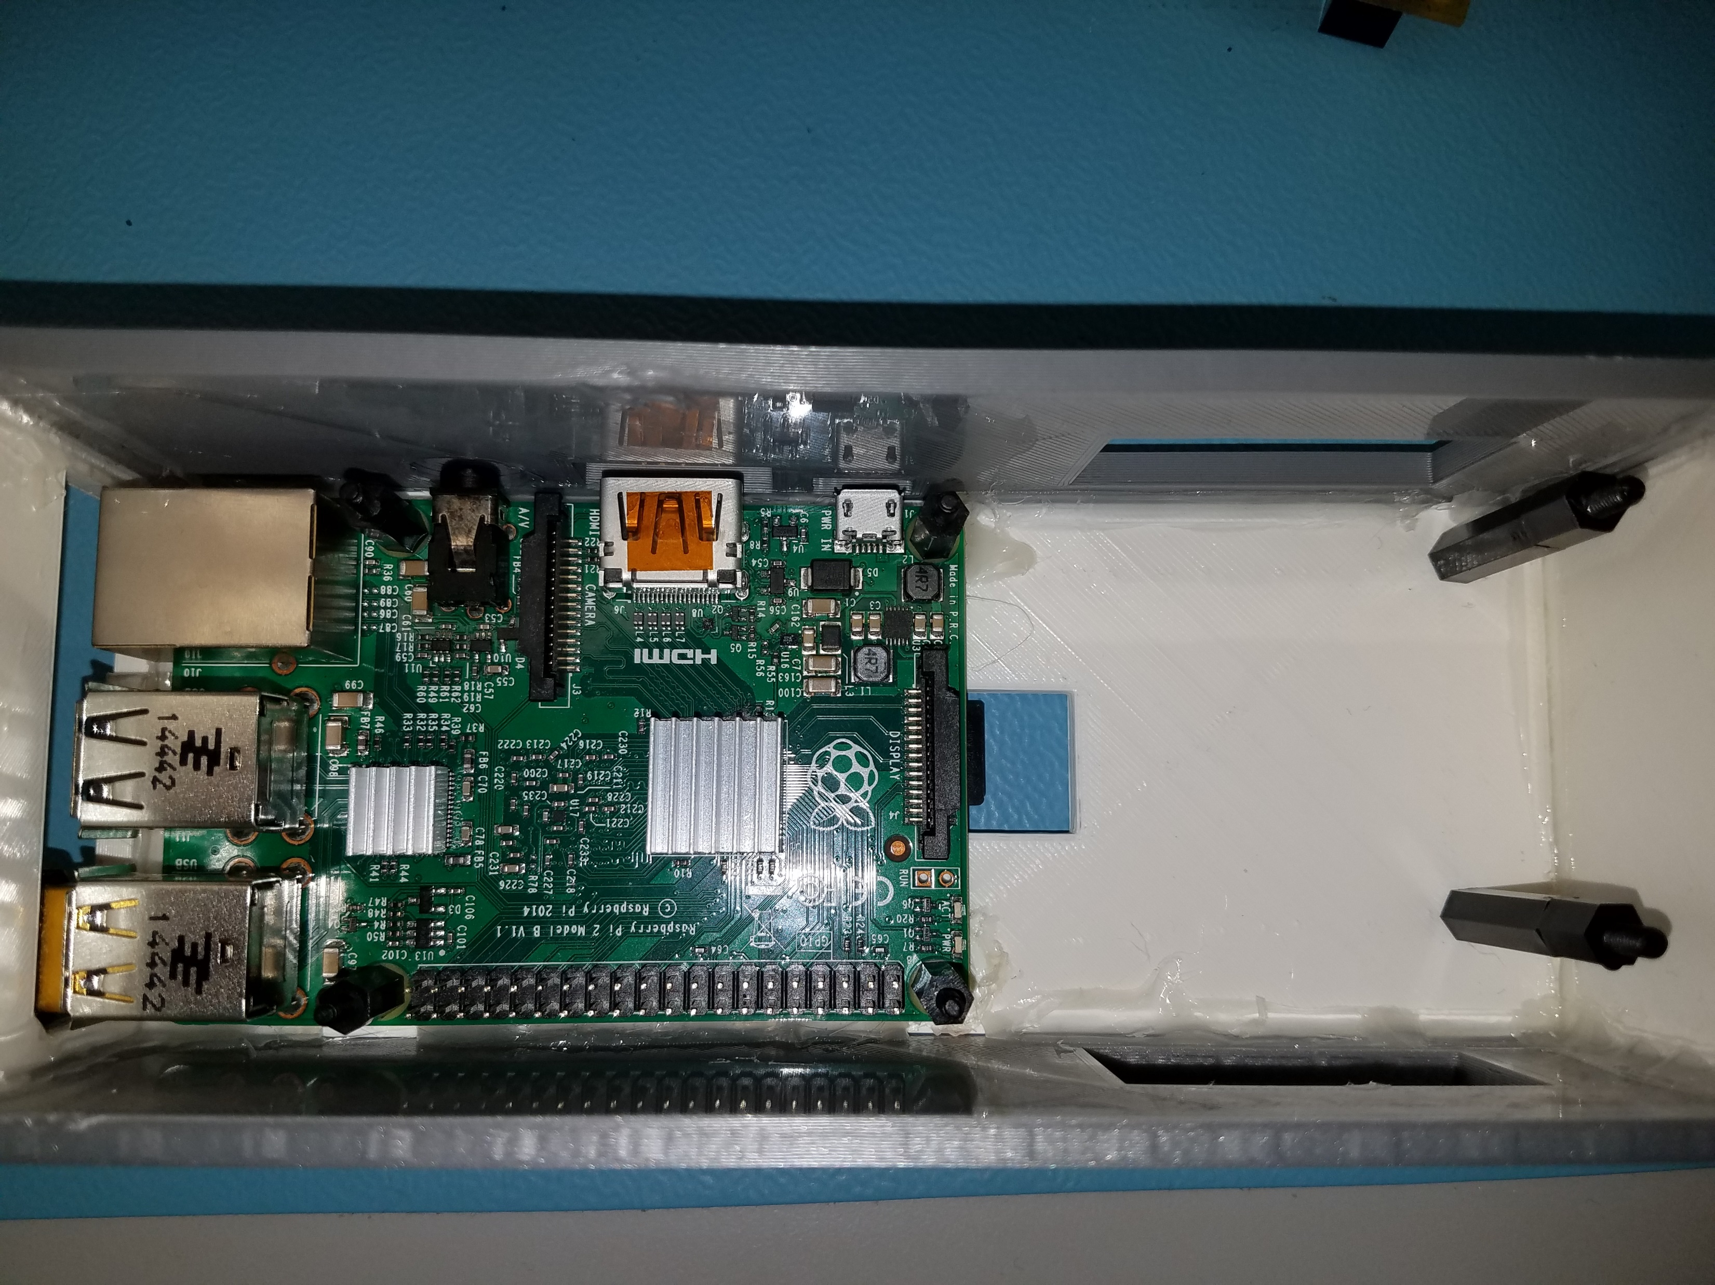
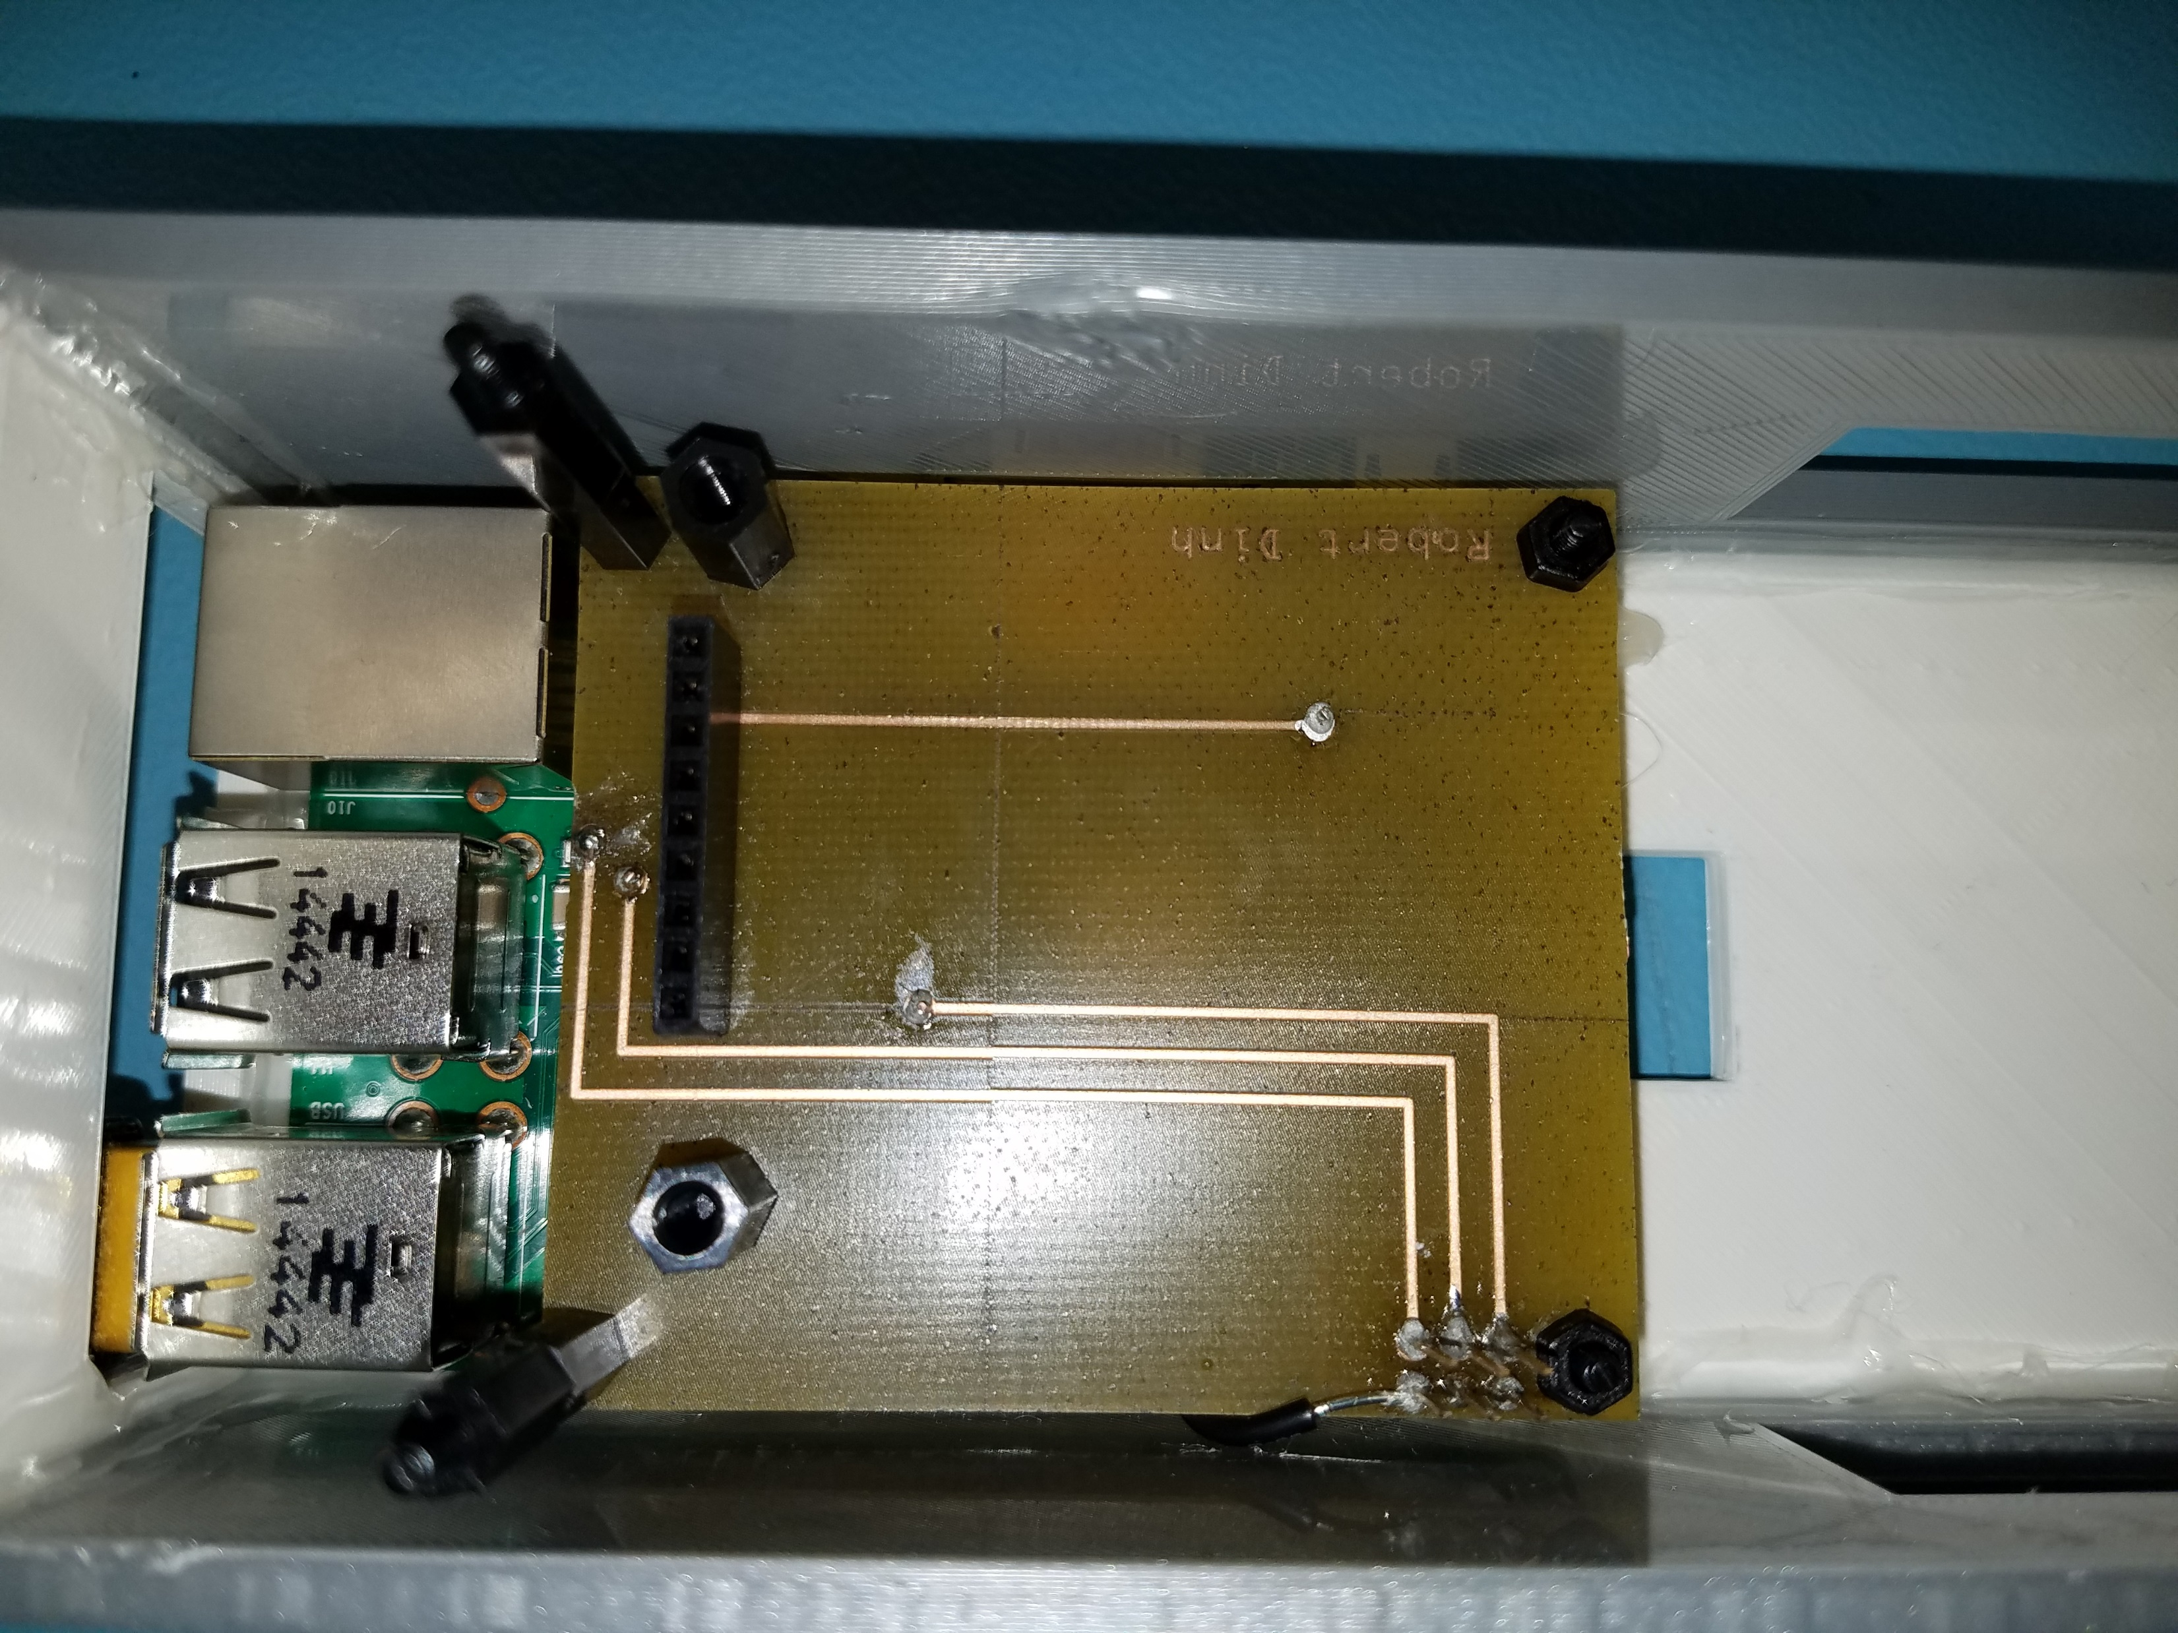
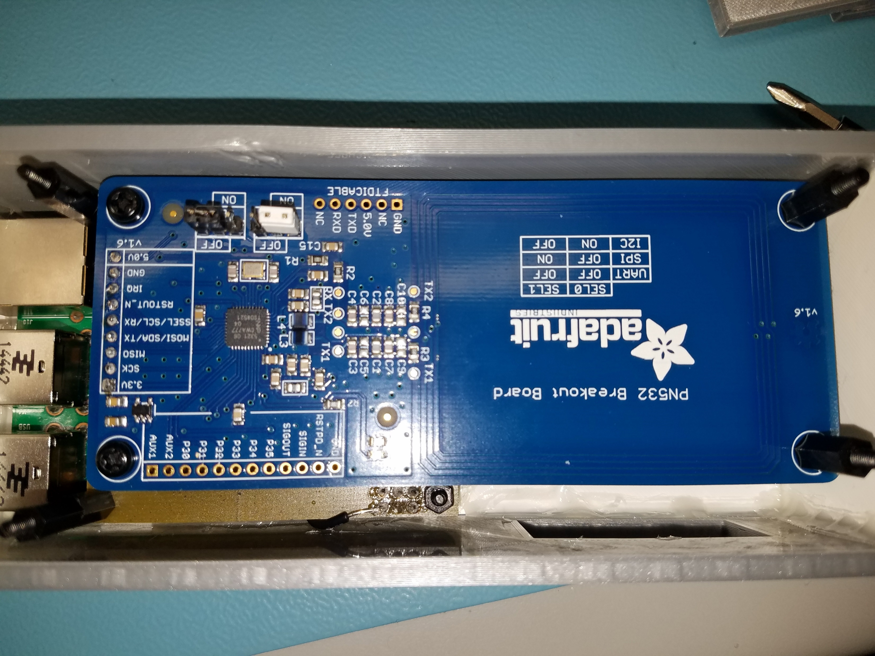
Images of the Project

Slide 6
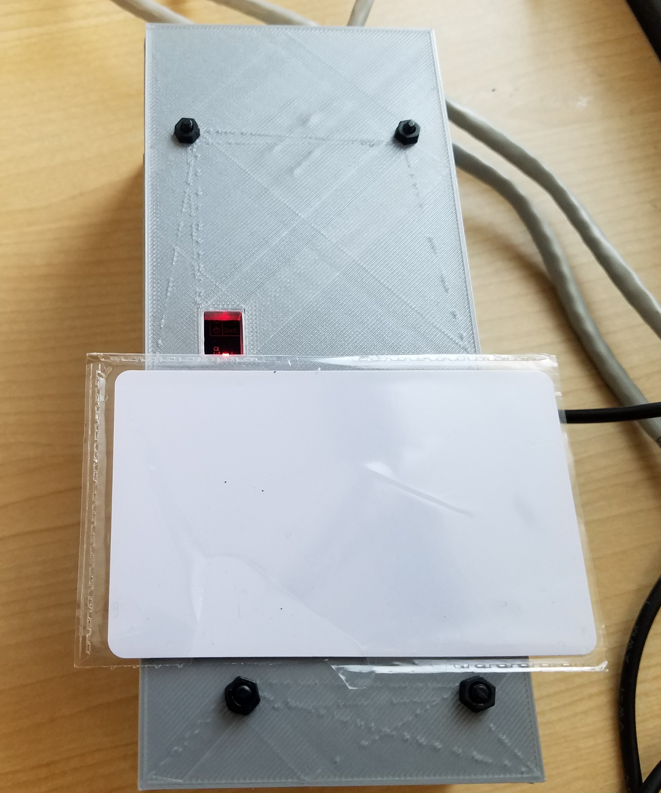
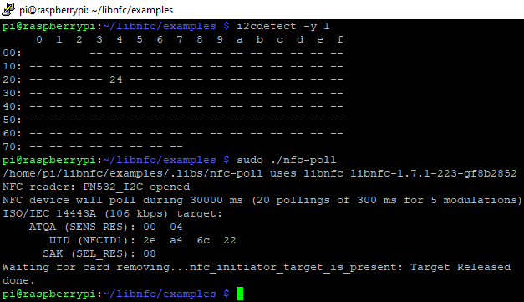
Images of the Project

Slide 7
Knowledge From Other Courses
Electric Circuits Tech 101 – Troubleshoot Breadboard\PCB
Electronic Devices and Circuits TECH 150 – Trouble Breadboard\PCB
Technical C Programming CENG153 – understanding C code, debugging and troubleshooting.
UNIX Scripting CENG200 - navigating the terminal
Embedded Systems CENG252 – Understanding C code, Understanding of I2C, troubleshoot hardware

